Slide 1
Dynamic
Hashing

Slide 2
Dynamic Hashing
Hashing in DBMS
Hashing is a DBMS technique for searching for needed data on the disc without utilizing an index structure.
The hashing method is basically used to index items and retrieve them in a DB
It is a method for calculating the direct position of an information record on the disk without the use of an index structure.
To generate the actual address of a data record, hash functions containing search keys as parameters are used.

Slide 3
Dynamic Hashing
Main Components of Hashing
Bucket – A bucket stores one entire disc block, which can store one or more records.
Hash Function – A hash function, abbreviated as h, refers to a mapping function that connects all of the search-keys K to that address in which the actual records are stored.
From the search keys to the bucket addresses, it’s a function.

Slide 4
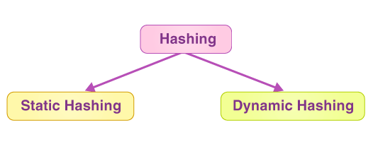
Dynamic Hashing
Types of Hashing
Hashing is of the following types:

Slide 5
Dynamic Hashing
Static Hashing in DBMS
Whenever a search-key value is specified in static hashing, the hash algorithm always returns the same address. For example, the mod-5 hash function will generate only 5 values. For this function, the output address must always be the same.
At all times, the number of buckets available remains constant throughout the process of static hashing
The resultant data bucket address with static hashing will always be the same. That is, if we use the hash function mod-5 to obtain an address for EMP ID =103, we will always get the same bucket address 3. The bucket address will not change in this case.

Slide 6
Dynamic Hashing
Static Hashing Operations
Search a Record: When a record is needed, the very same hash function is used in order to get the address of that bucket in which the data is kept.
Insert a Record: When a new record is entered into the table, the hash key is used to construct an address for the new record, and the record is placed there.
Delete a Record: To delete a record, we must first retrieve the record that will be destroyed. The records for this address will then be deleted from memory.
Update a Record: To edit a record, we’ll use a hash function to find it first, then change the data record.

Slide 7
Dynamic Hashing
Static Hashing Operations
If we wish to add a new record to the file, but the address of the data bucket formed by the hash function isn’t empty, or information already exists in that address, we can’t add the record. Bucket overflow is a term used in static hashing to describe this occurrence. This is a critical condition in this strategy.
To deal with this scenario, the most widely utilized methods are :
Open hashing and
Closed hashing

Slide 8
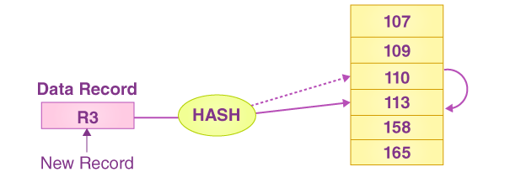
Dynamic Hashing
Open Hashing
Whenever a hash function generates any address that already contains data, the next bucket is assigned to it, and this process is called Linear probing.
For instance, if the record R3 needs to be entered, the hash function will generate 110 as R3’s address. However, the address is already full; as a result, the system selects 113 as the next available data bucket and assigns R3 to it.

Slide 9
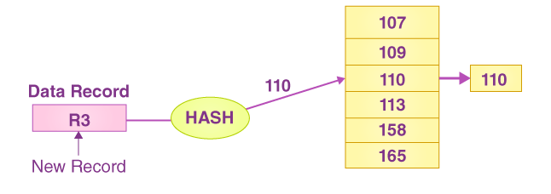
Dynamic Hashing
Closed Hashing
When a data bucket is full, a new one is created and connected after the old one, and this method is called Overflow chaining.
For example, if the record R3 needs to be added to the database, the hash function will assign it with the address 110. However, this bucket is too full to accommodate the additional data. In this scenario, a new bucket is placed and linked to the end of 110 buckets.

Slide 10
Dynamic Hashing
Dynamic Hashing in DBMS
The disadvantage of static hashing is that it doesn’t expand or contract dynamically as the database size grows or diminishes.
Dynamic hashing is a technology that allows data buckets to be created and withdrawn on the fly. It is also known as Extendible hashing.
In dynamic hashing, the hash function is designed to output a huge number of values, but only a few are used at first.
Dynamic hashing is a mechanism for dynamically adding and removing data buckets on demand.

Slide 11
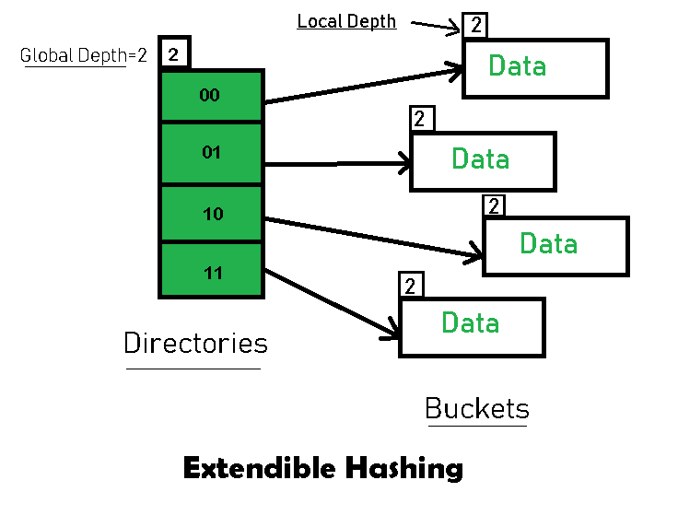
Dynamic Hashing
Basic Structure of Extendible Hashing

Slide 12
Dynamic Hashing
Basic Structure of Extendible Hashing
Directories: These containers store pointers to buckets. Each directory is given a unique id which may change each time when expansion takes place. The hash function returns this directory id which is used to navigate to the appropriate bucket. Number of Directories = 2^Global Depth.
Buckets: They store the hashed keys. Directories point to buckets. A bucket may contain more than one pointers to it if its local depth is less than the global depth.

Slide 13
Dynamic Hashing
Basic Structure of Extendible Hashing
Global Depth: It is associated with the Directories. They denote the number of bits which are used by the hash function to categorize the keys. Global Depth = Number of bits in directory id.
Local Depth: It is the same as that of Global Depth except for the fact that Local Depth is associated with the buckets and not the directories. Local depth in accordance with the global depth is used to decide the action that to be performed in case an overflow occurs. Local Depth is always less than or equal to the Global Depth.

Slide 14
Dynamic Hashing
Basic Structure of Extendible Hashing
Bucket Splitting: When the number of elements in a bucket exceeds a particular size, then the bucket is split into two parts.
Directory Expansion: Directory Expansion Takes place when a bucket overflows. Directory Expansion is performed when the local depth of the overflowing bucket is equal to the global depth.

Slide 15
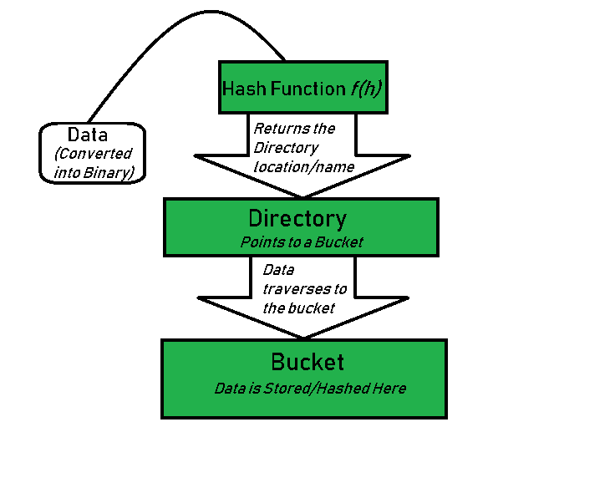
Dynamic Hashing
Basic Working of Extendible Hashing

Slide 16
Dynamic Hashing
Basic Working of Extendible Hashing
Step 1 – Analyze Data Elements:
Data elements may exist in various forms eg. Integer, String, Float, etc. Currently, let us consider data elements of type integer. eg: 49.
Step 2 – Convert into binary format:
Convert the data element in Binary form. For string elements, consider the ASCII equivalent integer of the starting character and then convert the integer into binary form. Since we have 49 as our data element, its binary form is 110001.

Slide 17
Dynamic Hashing
Basic Working of Extendible Hashing
Step 3 – Check Global Depth of the directory.
Suppose the global depth of the Hash-directory is 3.
Step 4 – Identify the Directory:
Consider the ‘Global-Depth’ number of LSBs in the binary number and match it to the directory id. For Example, the binary value of 49 is 110001 and the global-depth is 3. So, the hash function will return 3 LSBs of 110001 that is, 001.
Step 5 – Navigation: Now, navigate to the bucket pointed by the directory with directory-id 001.

Slide 18
Dynamic Hashing
Basic Working of Extendible Hashing
Step 6 – Insertion and Overflow Check:
Insert the element and check if the bucket overflows. If an overflow is encountered, go to step 7 followed by Step 8, otherwise, go to step 9.
Step 7 – Tackling Overflow Condition during Data Insertion:
Many times, while inserting data in the buckets, it might happen that the Bucket overflows. In such cases, we need to follow an appropriate procedure to avoid mishandling of data.

Slide 19
Dynamic Hashing
Basic Working of Extendible Hashing
First, Check if the local depth is less than or equal to the global depth. Then choose one of the cases below.
Case-1: If the local depth of the overflowing Bucket is equal to the global depth, then Directory Expansion, as well as Bucket Split, needs to be performed. Then increment the global depth and the local depth value by 1. And, assign appropriate pointers. Directory expansion will double the number of directories present in the hash structure.
Case-2: In case the local depth is less than the global depth, then only Bucket Split takes place. Then increment only the local depth value by 1. And, assign appropriate pointers.

Slide 20
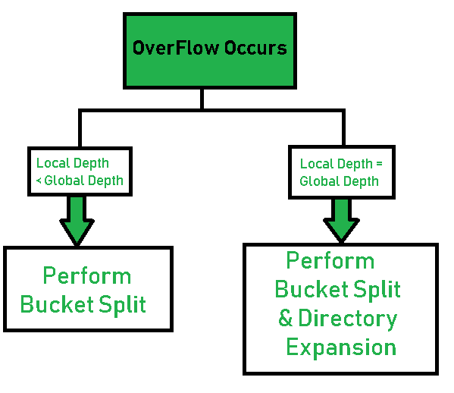
Dynamic Hashing
Basic Working of Extendible Hashing
Step 8 – Rehashing of Split Bucket Elements: The Elements present in the overflowing bucket that is split are rehashed w.r.t the new global depth of the directory.
Step 9 – The element is successfully hashed.

Slide 21
Dynamic Hashing
Algorithm for Inserting New Record into the Dynamic/Extendible Hash Structure
The following steps explain how the algorithm works:
Step-1: Initialize the bucket depths and the global depth of the directories.
Step-2: Convert data into a binary representation.
Step-3: Consider the "global depth" number of the least significant bits (LSBs) of data.
Step-4: Map the data according to the ID of a directory.

Slide 22
Dynamic Hashing
Algorithm for Inserting New Record into the Dynamic/Extendible Hash Structure
Step-5: Check for the following conditions if a bucket overflows (if the number of elements in a bucket exceeds the set limit):
i. If Global depth = bucket depth: Split the bucket into two and increment the global depth and the buckets' depth. Re-hash the elements that were present in the split bucket.
ii. Global depth > bucket depth: Split the bucket into two and increment the bucket depth only. Re-hash the elements that were present in the split bucket.
Step-6: Repeat the steps above for each element.

Slide 23
Dynamic Hashing
Searching Algorithm
When searching for a key, the hash function computes the key's hash value, and the resulting index is used to quickly locate the key's value in the table.
Input: Key k and hash table.
Compute Hash: Compute the hash value h for the key.
h = hash_function(k)
Determine Index: Use the first n bits of h to find the directory index.
index = h[0:n]
Locate Bucket: Access the bucket at the computed index.
Search in Bucket:
Check if the key k exists in the bucket.
If found, return the corresponding value.
If not found, return an error message (key does not exist).
End.

Slide 24
Dynamic Hashing
Example
Consider the following elements:
16, 4, 6, 22, 24, 10, 31, 7, 9, 20, 26
Construct the extendible hash structure for Bucket Size=3.
Solution:

Slide 25
Dynamic Hashing
Example
Solution: Calculate the binary forms of each of the given key elements.
Key element | Binary form
16 | 10000
4 | 00100
6 | 00110
22 | 10110
24 | 11000
10 | 01010
31 | 11111
7 | 00111
9 | 01001
20 | 10100
26 | 11010

Slide 26
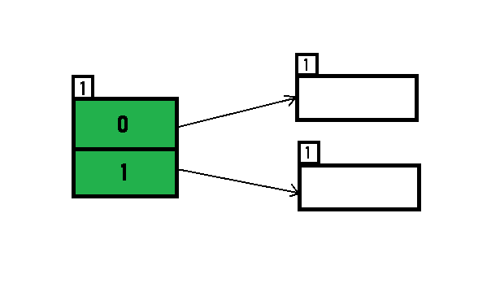
Dynamic Hashing
Example
Solution: Initially, the global-depth and local-depth is always 1. Thus, the hashing frame looks like this:
Key element | Binary form
16 | 10000
4 | 00100
6 | 00110
22 | 10110
24 | 11000
10 | 01010
31 | 11111
7 | 00111
9 | 01001
20 | 10100
26 | 11010

Slide 27
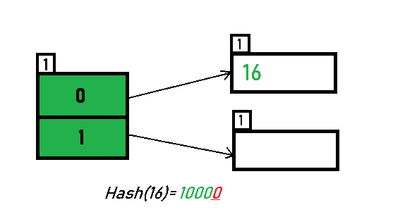
Dynamic Hashing
Example
Inserting 16: The binary format of 16 is 10000 and global-depth is 1. The hash function returns 1 LSB of 10000 which is 0. Hence, 16 is mapped to the directory with id=0.
Key element | Binary form
16 | 10000
4 | 00100
6 | 00110
22 | 10110
24 | 11000
10 | 01010
31 | 11111
7 | 00111
9 | 01001
20 | 10100
26 | 11010

Slide 28
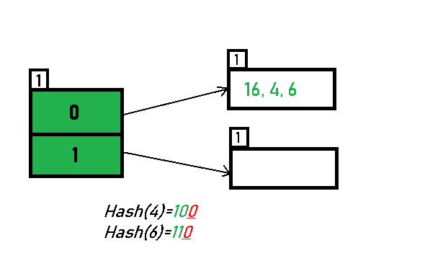
Dynamic Hashing
Example
Inserting 4 and 6: Both 4(00100) and 6(00110) have 0 in their LSB. Hence, they are hashed as follows:
Key element | Binary form
16 | 10000
4 | 00100
6 | 00110
22 | 10110
24 | 11000
10 | 01010
31 | 11111
7 | 00111
9 | 01001
20 | 10100
26 | 11010

Slide 29
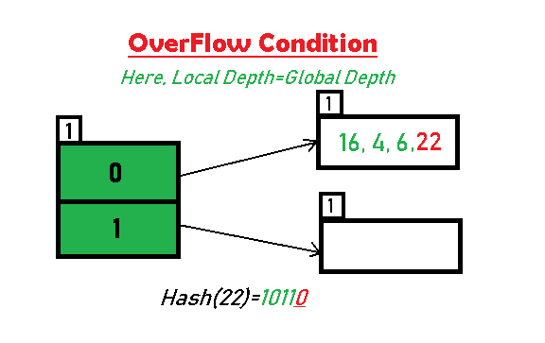
Dynamic Hashing
Example
Inserting 22: The binary form of 22 is 10110. Its LSB is 0. The bucket pointed by directory 0 is already full. Hence, Overflow occurs.
Key element | Binary form
16 | 10000
4 | 00100
6 | 00110
22 | 10110
24 | 11000
10 | 01010
31 | 11111
7 | 00111
9 | 01001
20 | 10100
26 | 11010

Slide 30
Dynamic Hashing
Example
As directed by Step 7-Case 1, Since Local Depth = Global Depth, the bucket splits and directory expansion takes place. Also, rehashing of numbers present in the overflowing bucket takes place after the split. And, since the global depth is incremented by 1, now, the global depth is 2. Hence, 16, 4, 6, 22 are now rehashed w. r. t 2 LSBs. [16(10000), 4(00100), 6(00110), 22(10110)].
Key element | Binary form
16 | 10000
4 | 00100
6 | 00110
22 | 10110
24 | 11000
10 | 01010
31 | 11111
7 | 00111
9 | 01001
20 | 10100
26 | 11010

Slide 31
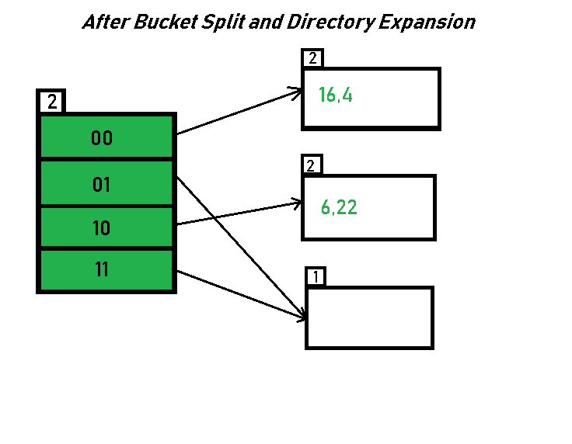
Dynamic Hashing
Example
Key element | Binary form
16 | 10000
4 | 00100
6 | 00110
22 | 10110
24 | 11000
10 | 01010
31 | 11111
7 | 00111
9 | 01001
20 | 10100
26 | 11010

Slide 32
Dynamic Hashing
Example
The bucket which was underflow has remained untouched. The number of directories has doubled, we now have 2 directories 01 and 11 pointing to the same bucket. This is because the local-depth of the bucket has remained 1. Any bucket having a local depth less than the global depth is pointed-to by more than one directories.
Key element | Binary form
16 | 10000
4 | 00100
6 | 00110
22 | 10110
24 | 11000
10 | 01010
31 | 11111
7 | 00111
9 | 01001
20 | 10100
26 | 11010

Slide 33
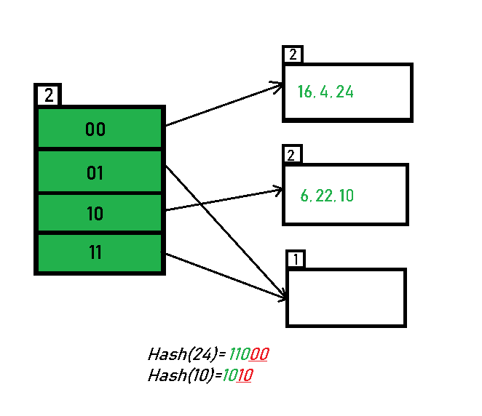
Dynamic Hashing
Example
Inserting 24 and 10: 24(11000) and 10 (01010) can be hashed based on directories with id 00 and 10. Here, we encounter no overflow condition.
Key element | Binary form
16 | 10000
4 | 00100
6 | 00110
22 | 10110
24 | 11000
10 | 01010
31 | 11111
7 | 00111
9 | 01001
20 | 10100
26 | 11010

Slide 34
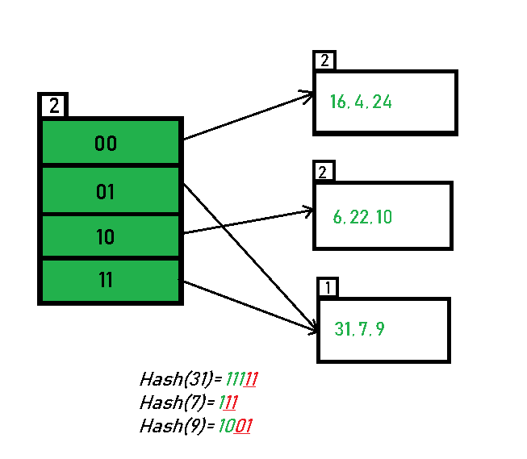
Dynamic Hashing
Example
Inserting 31, 7, 9: All of these elements [31(11111), 7(00111), 9(01001)] have either 01 or 11 in their LSBs. Hence, they are mapped on the bucket pointed out by 01 and 11. We do not encounter any overflow condition here.
Key element | Binary form
16 | 10000
4 | 00100
6 | 00110
22 | 10110
24 | 11000
10 | 01010
31 | 11111
7 | 00111
9 | 01001
20 | 10100
26 | 11010

Slide 35
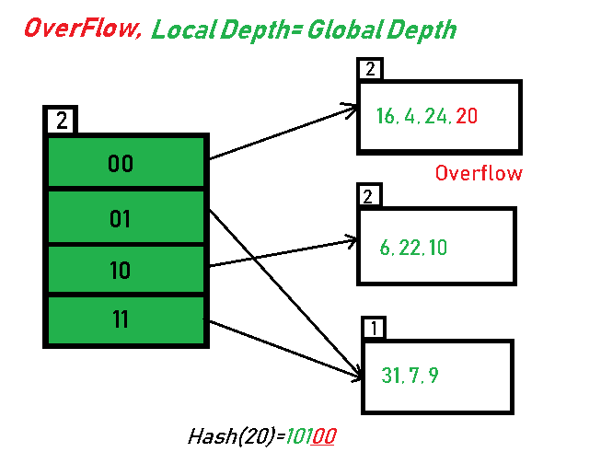
Dynamic Hashing
Example
Inserting 20: Insertion of data element 20 (10100) will again cause the overflow problem.
Key element | Binary form
16 | 10000
4 | 00100
6 | 00110
22 | 10110
24 | 11000
10 | 01010
31 | 11111
7 | 00111
9 | 01001
20 | 10100
26 | 11010

Slide 36
Dynamic Hashing
Example
20 is inserted in bucket pointed out by 00. As directed by Step 7-Case 1, since the local depth of the bucket = global-depth, directory expansion (doubling) takes place along with bucket splitting. Elements present in overflowing bucket are rehashed with the new global depth.
Key element | Binary form
16 | 10000
4 | 00100
6 | 00110
22 | 10110
24 | 11000
10 | 01010
31 | 11111
7 | 00111
9 | 01001
20 | 10100
26 | 11010

Slide 37
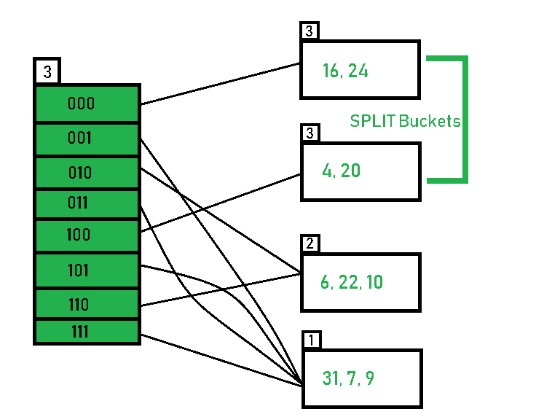
Dynamic Hashing
Example
Now, the new Hash table looks
like this.
Key element | Binary form
16 | 10000
4 | 00100
6 | 00110
22 | 10110
24 | 11000
10 | 01010
31 | 11111
7 | 00111
9 | 01001
20 | 10100
26 | 11010

Slide 38
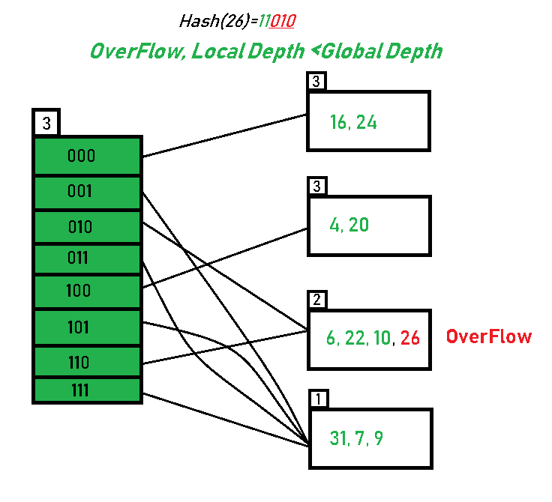
Dynamic Hashing
Example
Inserting 26: Global depth is 3. Hence, 3 LSBs of 26(11010) are considered. Therefore 26 best fits in the bucket pointed out by directory 010. Overflow occurs.
Key element | Binary form
16 | 10000
4 | 00100
6 | 00110
22 | 10110
24 | 11000
10 | 01010
31 | 11111
7 | 00111
9 | 01001
20 | 10100
26 | 11010

Slide 39
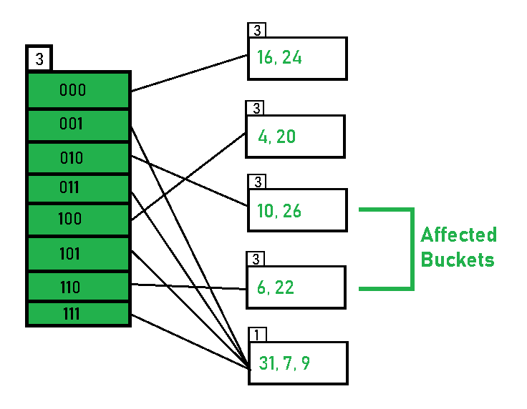
Dynamic Hashing
Example
As directed by Step 7-Case 2, since the local depth of bucket < Global depth (2<3), directories are not doubled but, only the bucket is split and elements are rehashed.
Key element | Binary form
16 | 10000
4 | 00100
6 | 00110
22 | 10110
24 | 11000
10 | 01010
31 | 11111
7 | 00111
9 | 01001
20 | 10100
26 | 11010

Slide 40
Dynamic Hashing
Example
Finally, the output of hashing the given list of numbers is obtained.
Key element | Binary form
16 | 10000
4 | 00100
6 | 00110
22 | 10110
24 | 11000
10 | 01010
31 | 11111
7 | 00111
9 | 01001
20 | 10100
26 | 11010

Slide 41
Dynamic Hashing
Key Observations
A Bucket will have more than one pointers pointing to it if its local depth is less than the global depth.
When overflow condition occurs in a bucket, all the entries in the bucket are rehashed with a new local depth.
The size of a bucket cannot be changed after the data insertion process begins.

Slide 42
Dynamic Hashing
Pros and Cons of Dynamic Hashing
Advantages: Dynamic Hashing Pros
Data retrieval is less expensive (in terms of computing).
No problem of Data-loss since the storage capacity increases dynamically.
With dynamic changes in hashing function, associated old values are rehashed w.r.t the new hash function.
Performance will not get affected as the amount of data grows in the system. To accommodate the data, size of memory will be increased.
Dynamic hashing improves the utilization of the memory.
This method is efficient to handle the dynamic database where size of data changes frequently.

Slide 43
Dynamic Hashing
Pros and Cons of Dynamic Hashing
Limitations: Dynamic Hashing Cons
The directory size may increase significantly if several records are hashed on the same directory while keeping the record distribution non-uniform.
Size of every bucket is fixed.
Memory is wasted in pointers when the global depth and local depth difference becomes drastic.
In dynamic hashing, bucket overflow can happen.
This method is complicated to code.

Slide 44
Dynamic Hashing
Indexing VS Hashing in DBMS
Data Retrieval Speed:
Indexing: With its pre-organized data structures, Indexing offers faster data retrieval, especially for range queries and ordered records.
Hashing: Hashing outperforms Indexing when searching for specific items, especially in large databases.
Storage Efficiency:
Indexing: While Indexes provide optimized search, they come with the cost of additional storage space.
Hashing: Hashing uses a dynamic allocation of buckets, ensuring better storage efficiency, particularly for databases with varying data sizes.

Slide 45
Dynamic Hashing
Indexing VS Hashing in DBMS
Database Size:
Indexing: Indexing works well for small to medium-sized databases where the additional storage overhead is manageable.
Hashing: Hashing shines in large databases, where it scales efficiently and maintains performance even with massive datasets.
Complexity:
Indexing: The complexity of Indexing increases with the number of indexes and their size, potentially affecting performance.
Hashing: Hashing offers a simpler and more straightforward method for data retrieval, reducing complexity for certain scenarios.

Slide 46
Dynamic Hashing
Indexing VS Hashing in DBMS
Applications: Indexing
Online Transaction Processing (OLTP) Systems: Indexing is well-suited for OLTP systems, where rapid data retrieval is essential for handling numerous concurrent user requests.
Range Queries: When dealing with queries involving a range of values, ordered indexing can significantly speed up search times.
Applications: Hashing
Large Databases: Hashing excels in large databases, where its direct location calculation ensures fast access to records without the need for complex index structures.
Searching Unsorted Data: When data is unsorted, Hashing can still efficiently retrieve desired items, whereas Indexing may require additional sorting operations.

Slide 47
Dynamic Hashing
Example
Consider the following data to construct the dynamic/extendible hash structure:
Data = {28, 4, 19, 1, 22, 16, 12, 0, 5, 7}
Bucket limit = 3
Solution:

Slide 48
Dynamic Hashing
Example
Solution: Convert the data into binary representation:
Data | Binary Form
28 | 11100
4 | 00100
19 | 10011
1 | 00001
22 | 10110
16 | 10000
12 | 01100
0 | 00000
5 | 00101
7 | 00111

Slide 49
Dynamic Hashing
Example
Solution: Initialize the hash table with two initial directories and buckets. Set the global depth and bucket depth to 1
Local/Bucket Depth
Data | Binary Form
28 | 11100
4 | 00100
19 | 10011
1 | 00001
22 | 10110
16 | 10000
12 | 01100
0 | 00000
5 | 00101
7 | 00111
Global Depth
1
1
0
1
1
Directories
Buckets
Initial Hash structure

Slide 50
Dynamic Hashing
Example
Solution: Inserting 28 (11100). Global-depth is 1. The hash function returns 1 LSB of 11100 which is 0. Hence, 28 is mapped to the directory with id=0.
Local/Bucket Depth
Data | Binary Form
28 | 11100
4 | 00100
19 | 10011
1 | 00001
22 | 10110
16 | 10000
12 | 01100
0 | 00000
5 | 00101
7 | 00111
Global Depth
1
28
1
0
1
1
Directories
Buckets

Slide 51
Dynamic Hashing
Example
Solution: Inserting 4 (00100). The hash function returns 1 LSB of 00100 which is 0. Hence, 4 is mapped to the directory with id=0.
Data | Binary Form
28 | 11100
4 | 00100
19 | 10011
1 | 00001
22 | 10110
16 | 10000
12 | 01100
0 | 00000
5 | 00101
7 | 00111
Local/Bucket Depth
Global Depth
1
28, 4
1
0
1
1
Directories
Buckets

Slide 52
Dynamic Hashing
Example
Solution: Inserting 19 (10011). Add it to the "1" ID bucket as the hash function returns 1 LSB of 10011 which is 1.
Data | Binary Form
28 | 11100
4 | 00100
19 | 10011
1 | 00001
22 | 10110
16 | 10000
12 | 01100
0 | 00000
5 | 00101
7 | 00111
Local/Bucket Depth
Global Depth
1
28, 4
1
0
1
1
19
Directories
Buckets

Slide 53
Dynamic Hashing
Example
Solution: Inserting 1 (00001). Add it to the "1" ID bucket as the hash function returns 1 LSB of 00001 which is 1.
Data | Binary Form
28 | 11100
4 | 00100
19 | 10011
1 | 00001
22 | 10110
16 | 10000
12 | 01100
0 | 00000
5 | 00101
7 | 00111
Local/Bucket Depth
Global Depth
1
28, 4
1
0
1
1
19, 1
Directories
Buckets

Slide 54
Dynamic Hashing
Example
Solution: Inserting 22 (10110). Add it to the "0" ID bucket as the hash function returns 1 LSB of 10110 which is 0.
Data | Binary Form
28 | 11100
4 | 00100
19 | 10011
1 | 00001
22 | 10110
16 | 10000
12 | 01100
0 | 00000
5 | 00101
7 | 00111
Local/Bucket Depth
Global Depth
1
28, 4, 22
1
0
1
1
19, 1
Directories
Buckets

Slide 55
Dynamic Hashing
Example
Solution: Inserting 16 (10000). Adding it to the "0" ID bucket makes it overflow.
Data | Binary Form
28 | 11100
4 | 00100
19 | 10011
1 | 00001
22 | 10110
16 | 10000
12 | 01100
0 | 00000
5 | 00101
7 | 00111
Local/Bucket Depth
Global Depth
Overflow
1
28, 4, 22, 16
1
0
1
1
19, 1
Directories
Buckets

Slide 56
Dynamic Hashing
Example
Solution: Since Local Depth = Global Depth, the bucket splits and directory expansion takes place. Rehash the numbers present in the overflowing bucket after splitting the bucket. Global depth is incremented by 1. Now, the global depth is 2. Hence, 28, 4, 22, and 16 are now rehashed w. r. t 2 LSBs.
Data | Binary Form
28 | 11100
4 | 00100
19 | 10011
1 | 00001
22 | 10110
16 | 10000
12 | 01100
0 | 00000
5 | 00101
7 | 00111
Local/Bucket Depth
Global Depth
2
2
28, 4, 16
00
01
10
11
2
22
1
19, 1
Directories
Buckets

Slide 57
Dynamic Hashing
Example
Solution: Inserting 12 (01100). Adding it to the "00" ID bucket makes it overflow.
Data | Binary Form
28 | 11100
4 | 00100
19 | 10011
1 | 00001
22 | 10110
16 | 10000
12 | 01100
0 | 00000
5 | 00101
7 | 00111
Local/Bucket Depth
Global Depth
Overflow
2
2
28, 4, 16, 12
00
01
10
11
2
22
1
19, 1
Directories
Buckets

Slide 58
Dynamic Hashing
Example
Solution: Since Local Depth = Global Depth, the bucket splits and directory expansion takes place. Rehash the numbers present in the overflowing bucket after splitting the bucket. Global depth is incremented by 1. Now, the global depth is 3. Hence, 28, 4, 16 and 12 are now rehashed w. r. t 3 LSBs.
Global Depth
Local/Bucket Depth
Data | Binary Form
28 | 11100
4 | 00100
19 | 10011
1 | 00001
22 | 10110
16 | 10000
12 | 01100
0 | 00000
5 | 00101
7 | 00111
3
3
16
000
001
010
011
100
101
110
111
3
28, 4, 12
2
22
1
19, 1
Directories
Buckets

Slide 59
Dynamic Hashing
Example
Solution: Inserting 0 (00000). Add it to the "000" ID bucket as the hash function returns 3 LSB of 00000 which is 000.
Global Depth
Local/Bucket Depth
Data | Binary Form
28 | 11100
4 | 00100
19 | 10011
1 | 00001
22 | 10110
16 | 10000
12 | 01100
0 | 00000
5 | 00101
7 | 00111
3
3
16, 0
000
001
010
011
100
101
110
111
3
28, 4, 12
2
22
1
19, 1
Directories
Buckets

Slide 60
Dynamic Hashing
Example
Solution: Inserting 5 (00101). Add it to the “101" ID bucket as the hash function returns 3 LSB of 00101 which is 101.
Global Depth
Local/Bucket Depth
Data | Binary Form
28 | 11100
4 | 00100
19 | 10011
1 | 00001
22 | 10110
16 | 10000
12 | 01100
0 | 00000
5 | 00101
7 | 00111
3
3
16, 0
000
001
010
011
100
101
110
111
3
28, 4, 12
2
22
1
19, 1, 5
Directories
Buckets

Slide 61
Dynamic Hashing
Example
Solution: Inserting 7 (00111). Adding it to the “111" ID bucket makes it overflow.
Global Depth
Local/Bucket Depth
Data | Binary Form
28 | 11100
4 | 00100
19 | 10011
1 | 00001
22 | 10110
16 | 10000
12 | 01100
0 | 00000
5 | 00101
7 | 00111
3
3
16, 0
000
001
010
011
100
101
110
111
3
28, 4, 12
2
22
Overflow
1
19, 1, 5, 7
Directories
Buckets

Slide 62
Dynamic Hashing
Example
Solution: Here Bucket depth is less than global depth. So, only the bucket split is executed. Elements (19, 1, 5, 7) are re-hashed according to the global depth, which is still 3.
Global Depth
Local/Bucket Depth
Data | Binary Form
28 | 11100
4 | 00100
19 | 10011
1 | 00001
22 | 10110
16 | 10000
12 | 01100
0 | 00000
5 | 00101
7 | 00111
3
3
16, 0
000
001
010
011
100
101
110
111
3
28, 4, 12
2
22
2
1, 5
Directories
Buckets
2
19, 7

